Slide 1

Capstone Project Airbnb Bookings Analysis
Team Members:
Abhishek Kulkarni
Animesh Mahajan
Nileshkumar Lavand
Prajwal Kulkarni

Slide 2

Business Overview
Airbnb - “Air bed and breakfast”
Presence in 220 countries
It has 150 million customers worldwide
Revenue : 4.8$ billion in 2019
Business : Lodging, Hospitality
This dataset consists of booking data at various airbnb’s throughout NYC in 2019

Slide 3
Problem Statement & Business Objective
The main objective of this exploratory data analysis (EDA) project is to understand the dynamics of Airbnb rentals in New York City (NYC) by analyzing various factors such as pricing, availability, neighborhood groups, room types, and customer feedback. By examining the average price, number of listings, availability, and customer reviews, we aim to gain insights into the pricing patterns, popularity of neighborhoods, customer satisfaction, and market opportunities. This analysis will provide valuable information for potential investors or hosts to make informed decisions and understand the key factors influencing the success and profitability of Airbnb rentals in NYC.
Business Objective
The business objective is to maximize occupancy rates, profitability, and guest satisfaction in the client's Airbnb rental business in New York City.
Methodology
Data Acquisition & Overview
Data cleaning
Data wrangling
Data visualization
Conclusion

Slide 4
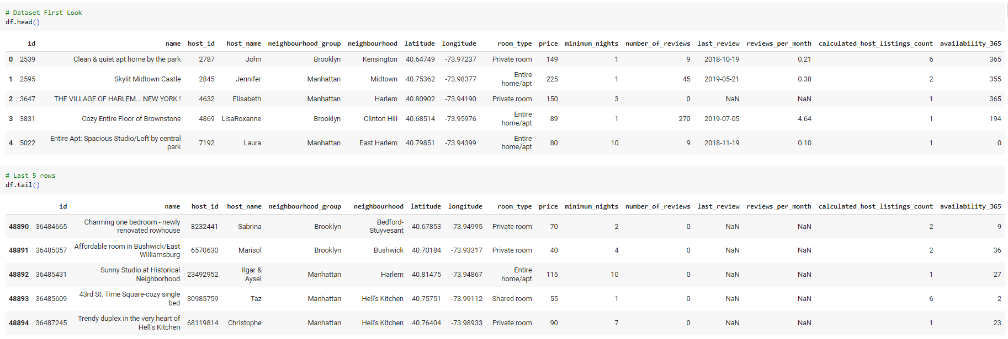
Dataset First Look
48894 Rows and 16 Columns

Slide 5
Data Summary
Airbnb Dataset
ID Host ID Latitude
Longitude
Price
Minimum nights
Number_of_reviews
Reviews_per_month Calculated_host_listings_count Availability 365
Name Host name Neighbourhood group Neighbourhood Room type
Last_review
Numerical Data
Categorical Data

Slide 6
Variables
Variable | Description | Datatype | Unique Values
Id | Unique ID of the Airbnb listing | int64 | 48895
name | Name of the Airbnb listing | object | 47905
host_id | Unique Host ID | int64 | 37457
host_name | Name of the Host | object | 11452
neighbourhood_group | Location | object | 5
neighbourhood | Area | object | 221
latitude | Latitude Range | float64 | 19048
longitude | Longitude Range | float64 | 14718

Slide 7
Variables
Variable | Description | Datatype | Unique Values
room_type | Type of Room listed | object | 3
price | Price of listing | int64 | 674
minimum_nights | Minimum nights to be paid for | int64 | 109
number_of_reviews | Number of reviews | int64 | 394
last_review | Last date of review | object | 1764
reviews_per_month | Number of reviews per month | float64 | 937
calculated_host_listings_count | Total count of listings of the host | int64 | 47
availability_365 | Availability around the year | int64 | 366

Slide 8
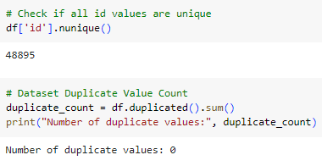
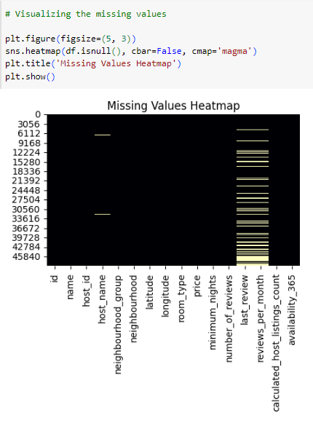
Data Cleaning
The dataset has no duplicate values
The dataset has null values in name, host_name, number_of_reviews & last_review column

Slide 9
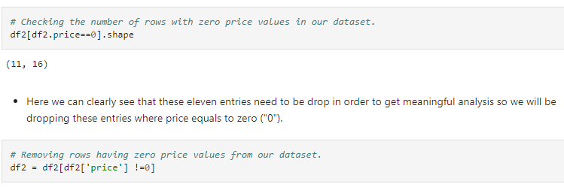
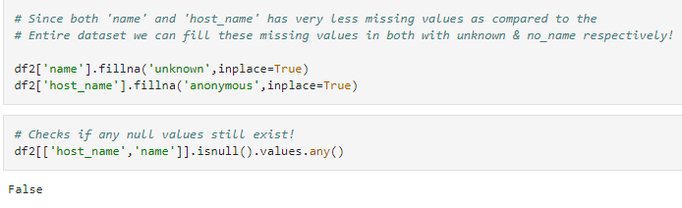
Data Wrangling

Slide 10
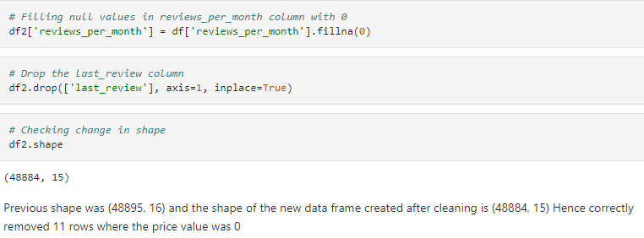
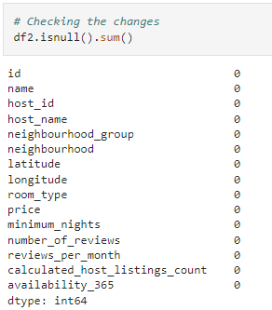
Data Wrangling (Contd)

Slide 11
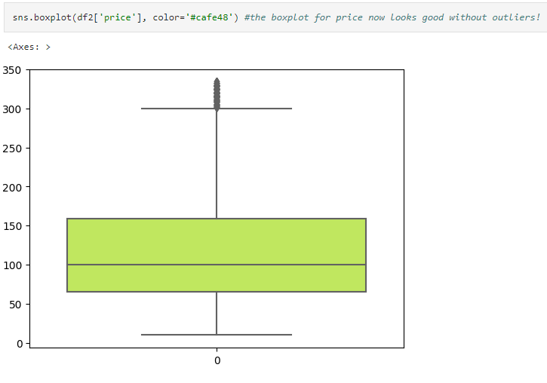
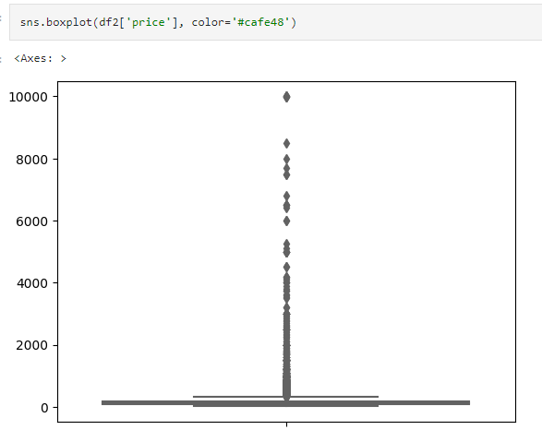
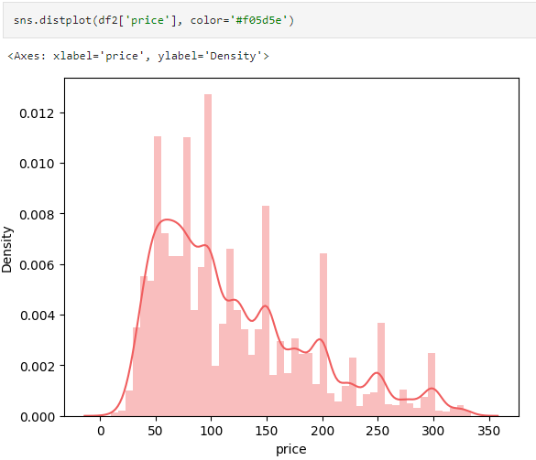
Data Wrangling (Contd)

Slide 12
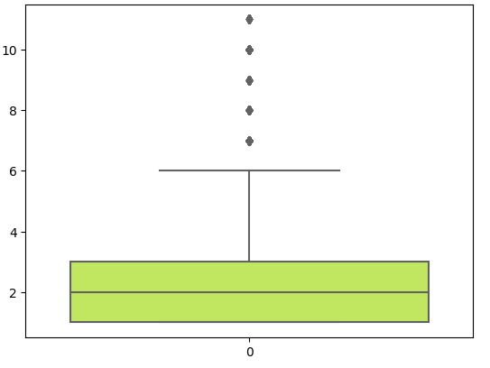
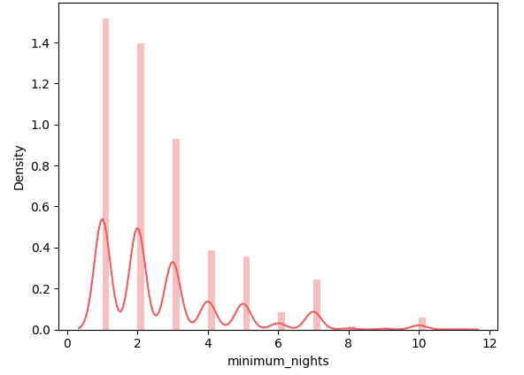
Data Wrangling (Contd)

Slide 13
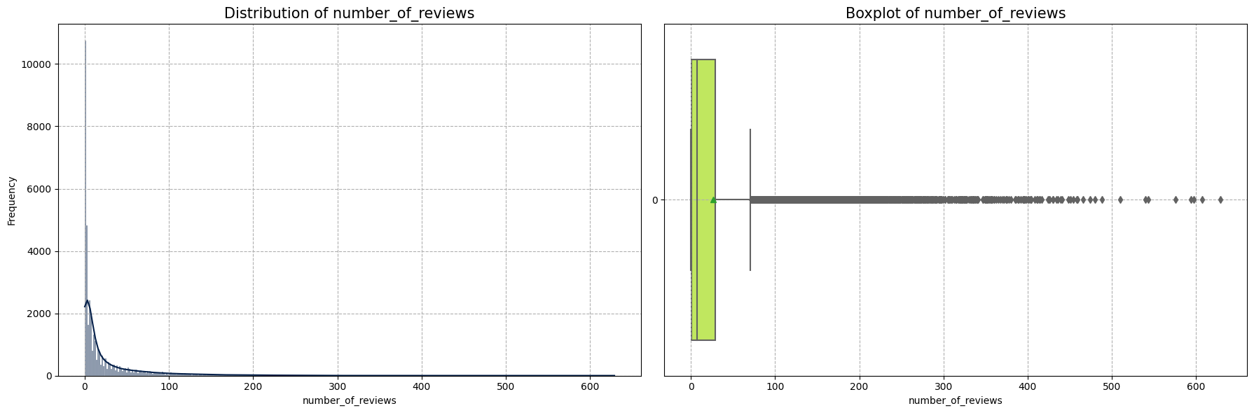
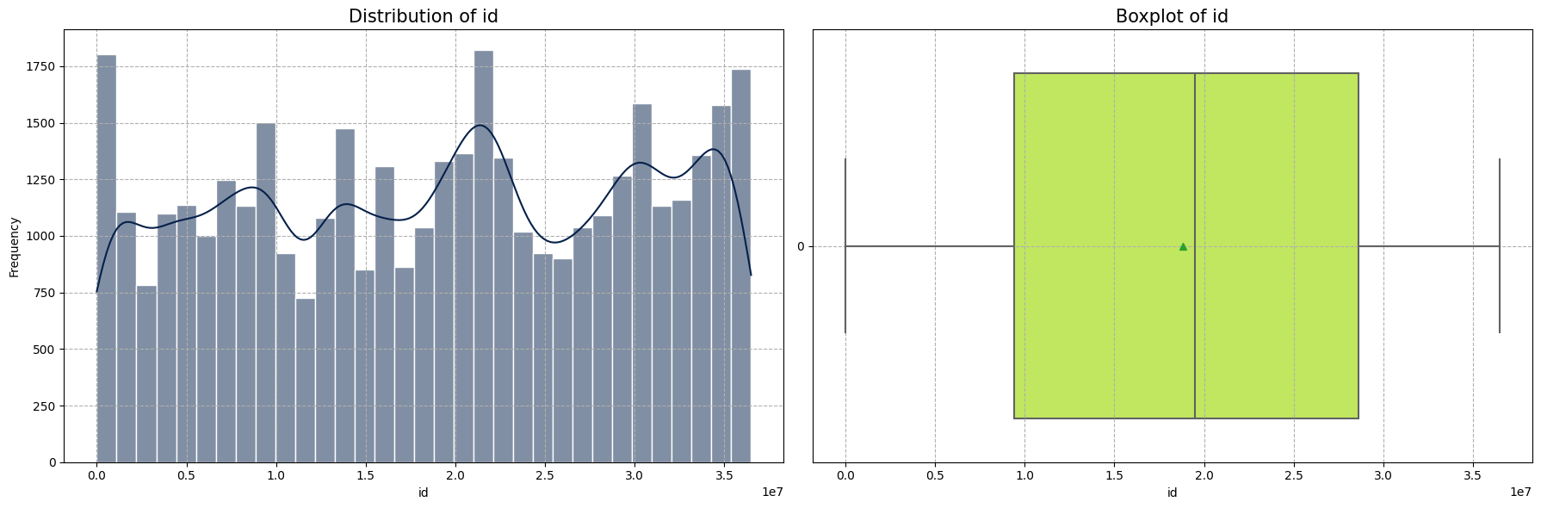
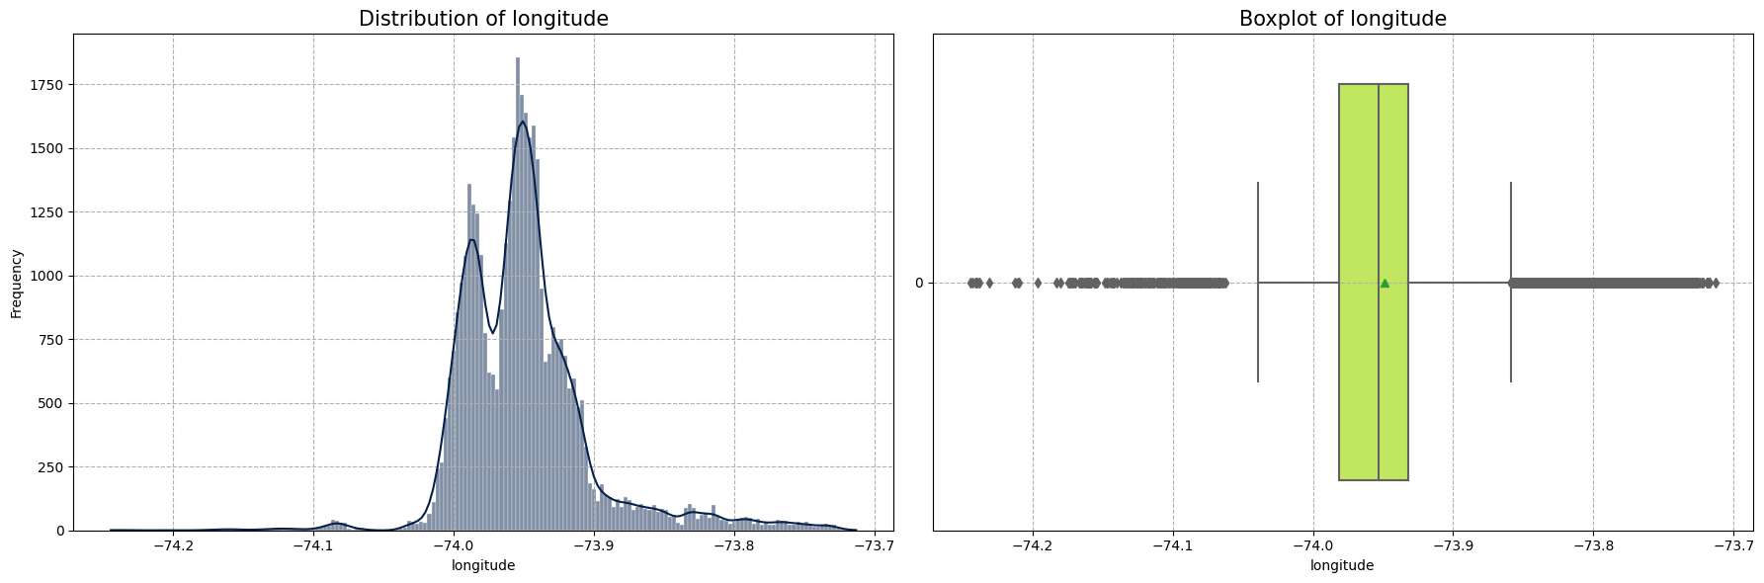
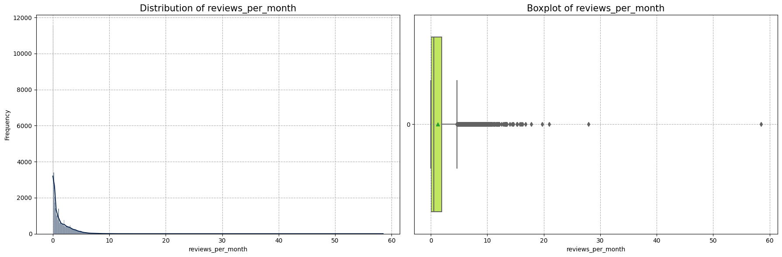
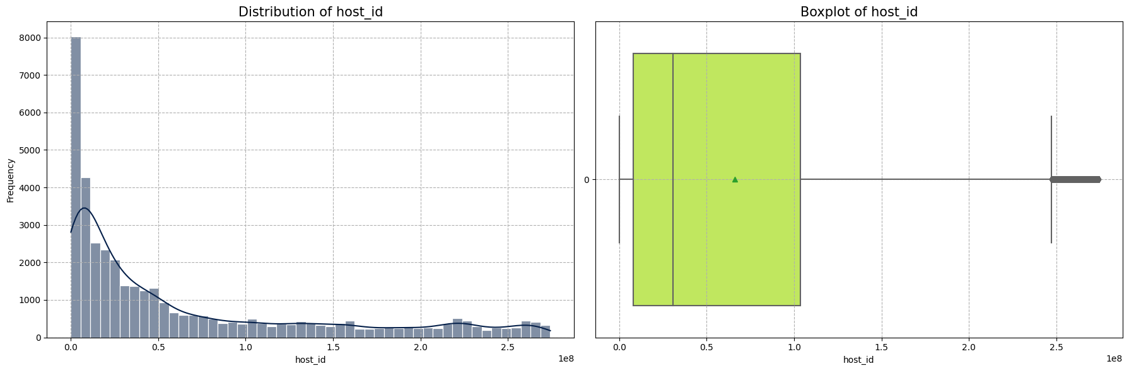
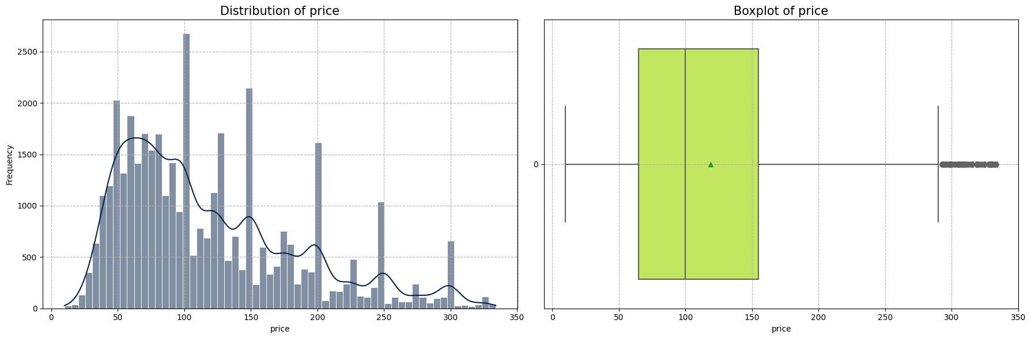
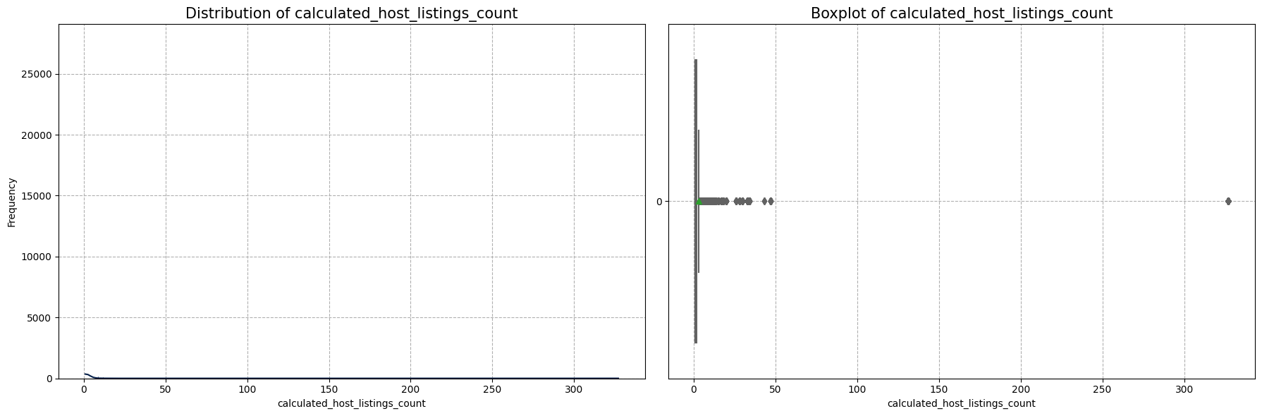
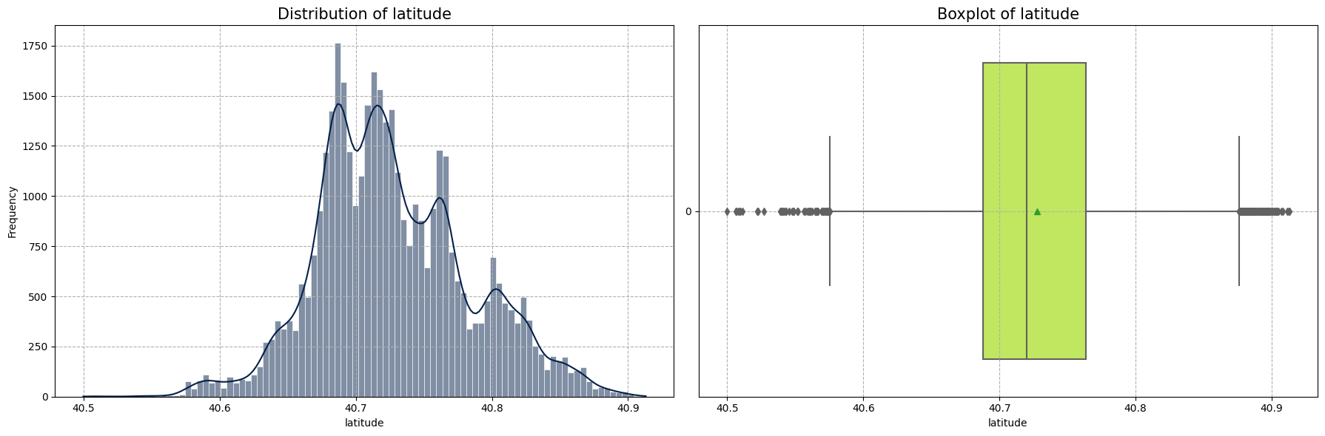
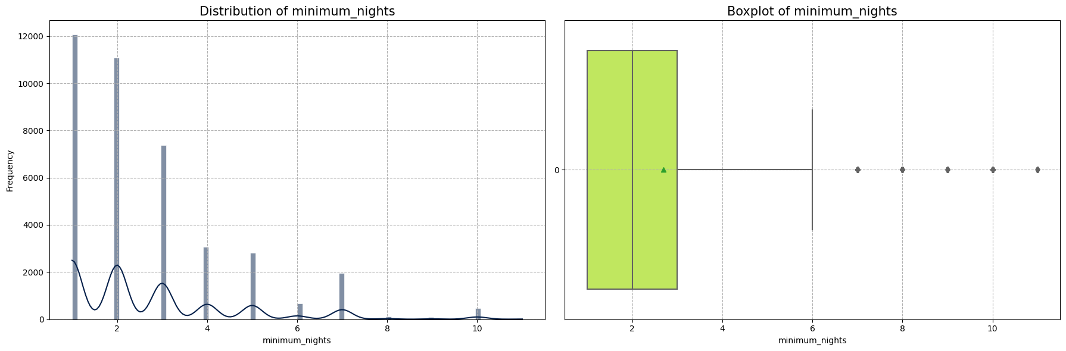
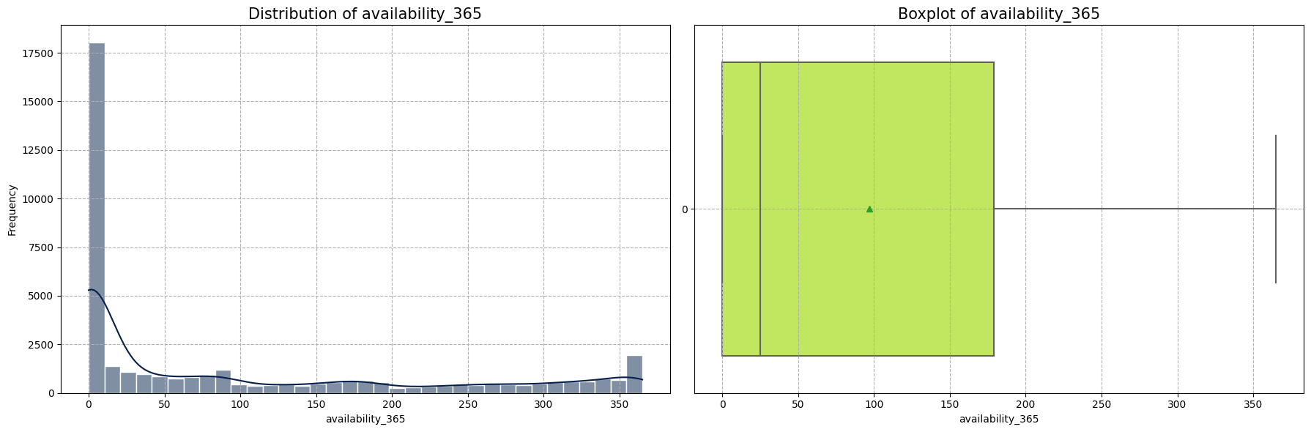
Data Visualization

Slide 14
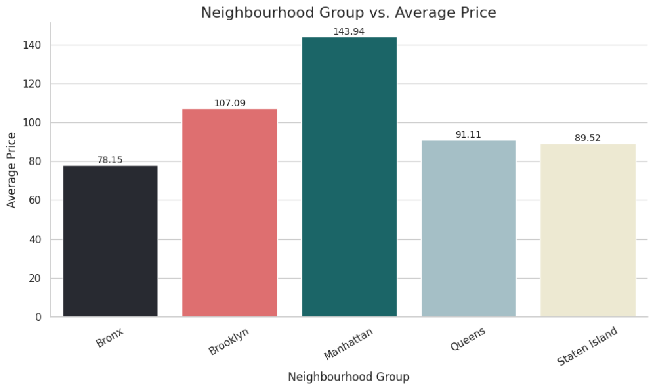
Data Visualization

Slide 15
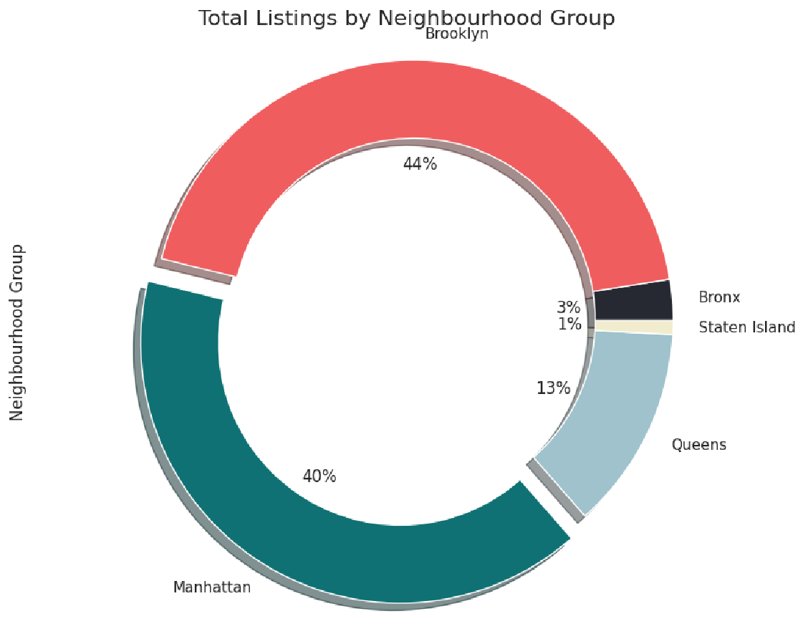
Data Visualization

Slide 16
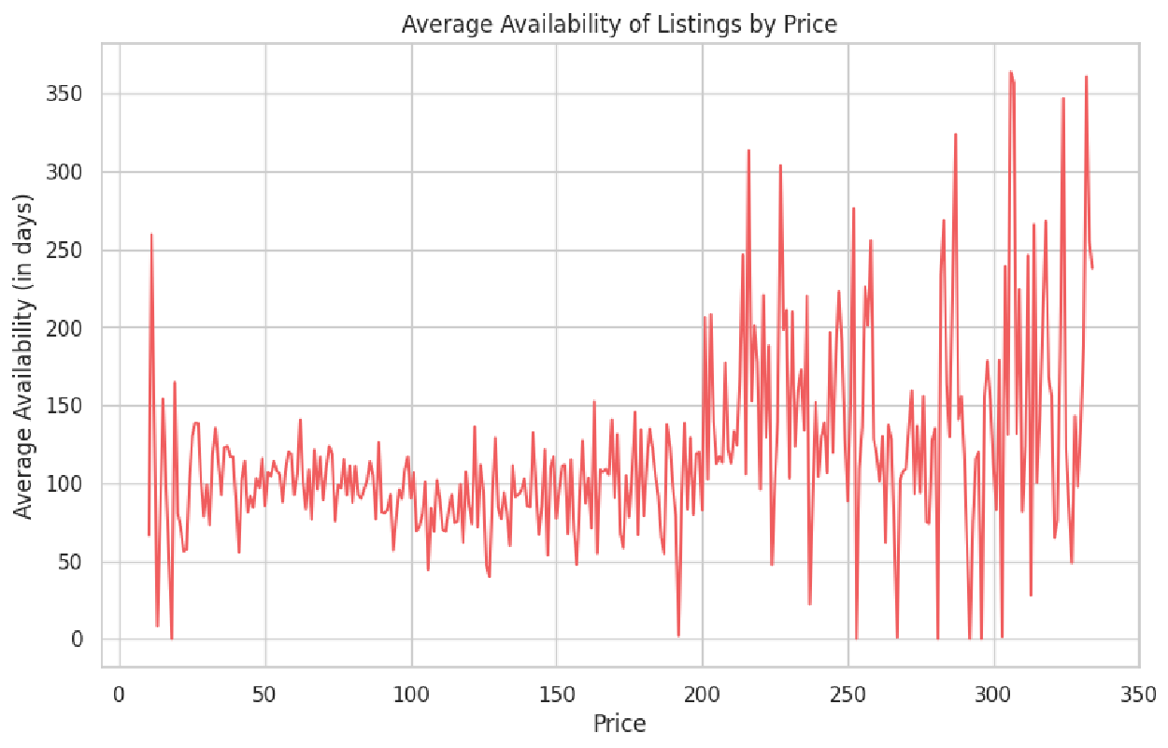
Data Visualization

Slide 17
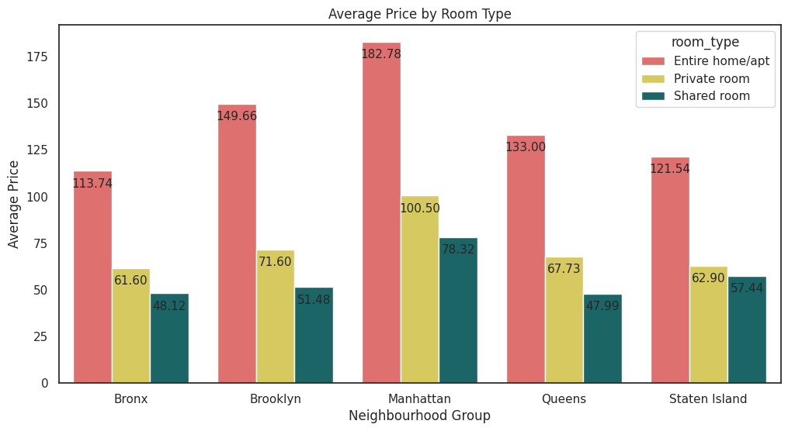
Data Visualization

Slide 18
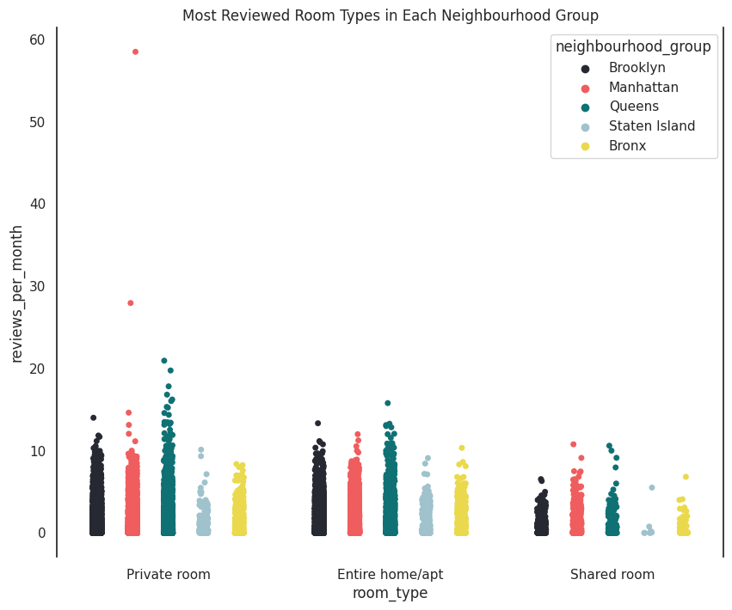
Data Visualization

Slide 19
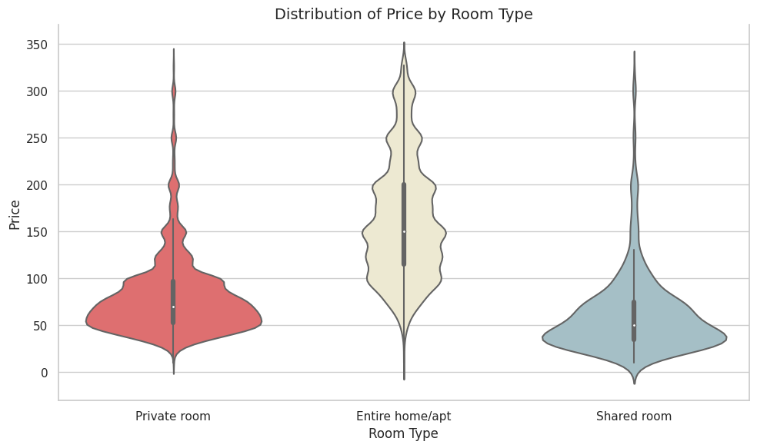
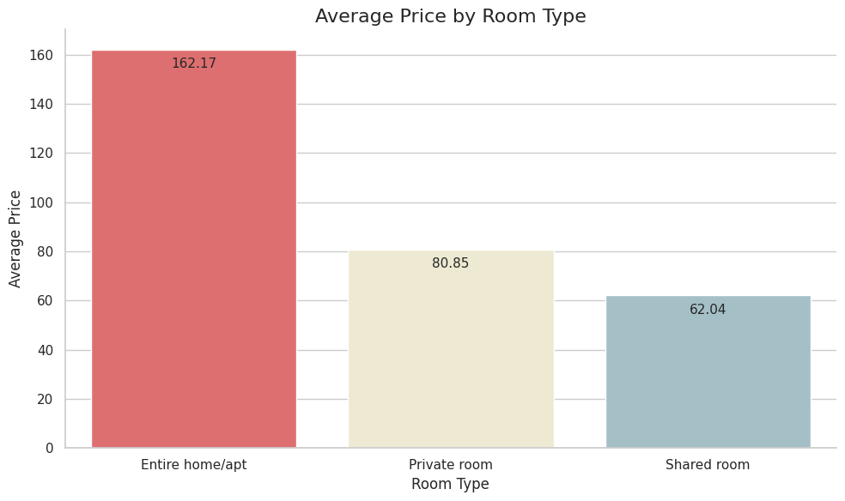
Data Visualization

Slide 20
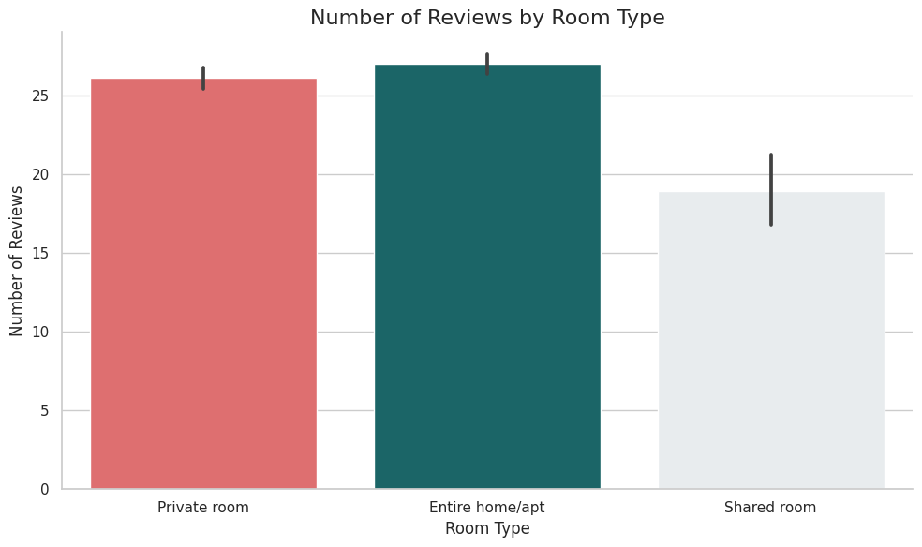
Data Visualization

Slide 21
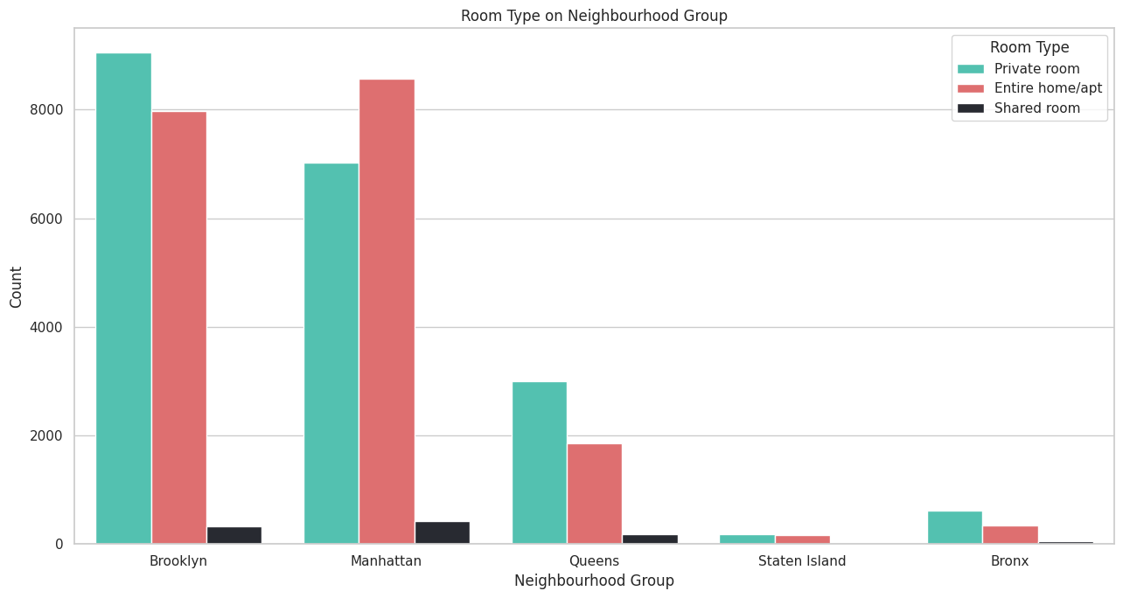
Data Visualization

Slide 22
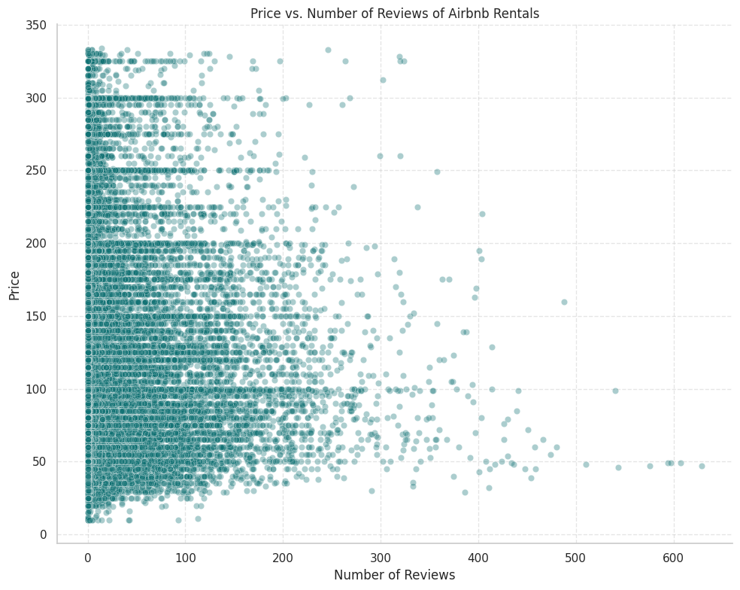
Data Visualization

Slide 23
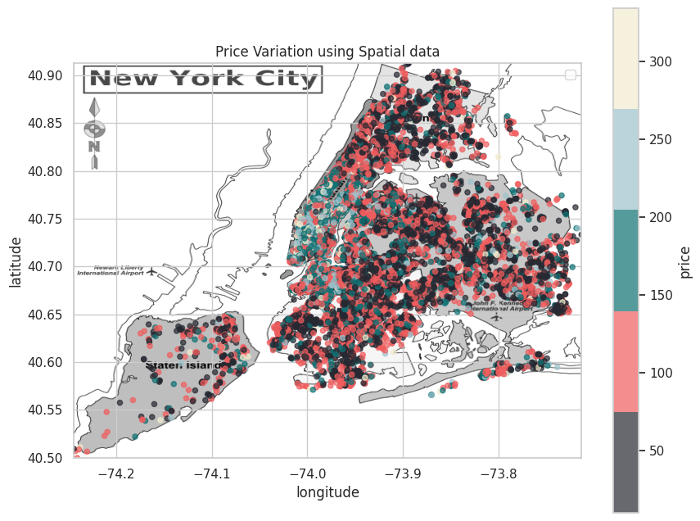
Data Visualization

Slide 24
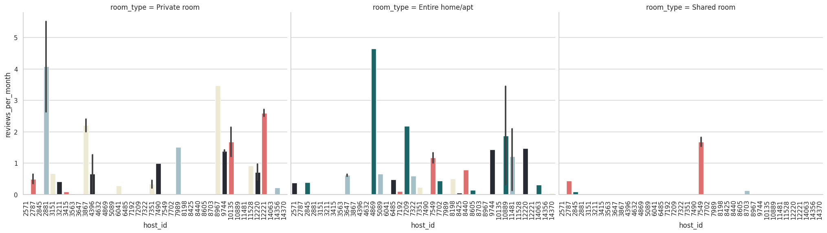
Data Visualization

Slide 25
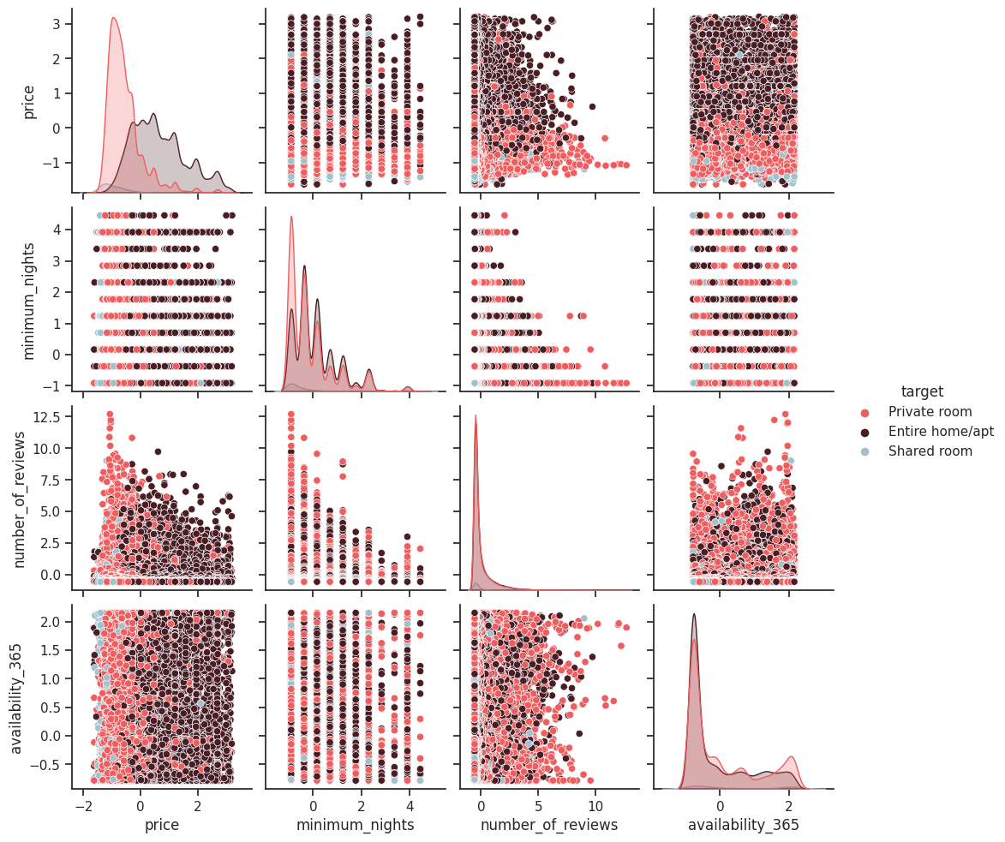
Data Visualization

Slide 26
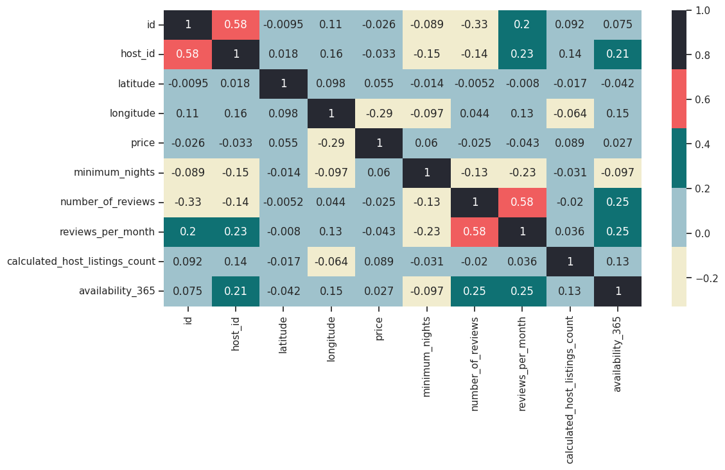
Data Visualization

Slide 27
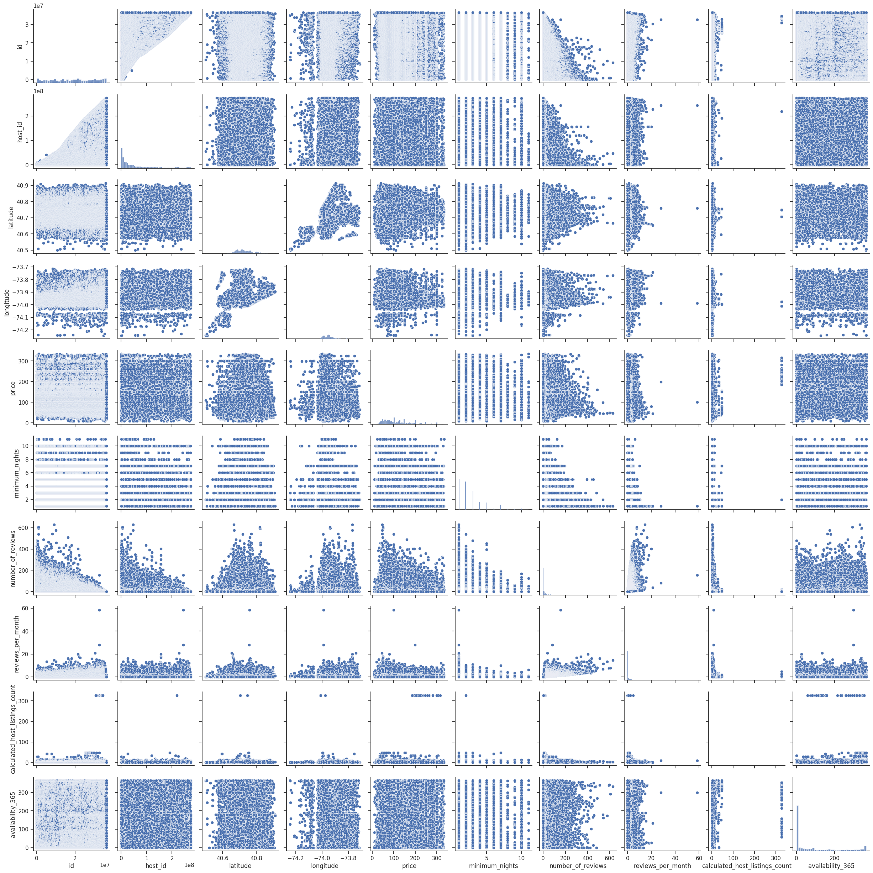
Data Visualization

Slide 28
Conclusion
The 2019 Airbnb NYC project revealed a significant growth in the number of listings in New York City, indicating a booming short-term rental market.
Manhattan emerged as the borough with the highest concentration of Airbnb listings.
Pricing analysis showed that Manhattan consistently had the highest average nightly rates, while the outer boroughs offered more affordable options.
Entire homes and apartments were the most common types of listings, indicating a preference for private accommodations among hosts and guests.
However, shared rooms were also available, catering to different budget and accommodation preferences.
Host demographics revealed that the majority of hosts in NYC were individuals who rented out their primary residences, suggesting a trend of using short-term rentals for additional income.
The presence of hosts with multiple listings highlighted the emergence of professional hosts and potential concerns around commercialization.
It is important to note that the project's findings were based on data of only 2019, and subsequent developments in regulations may have further shaped the market dynamics.

Slide 29
Solution to Business Problems
Optimize pricing strategy based on factors like location, property type, and amenities to maximize occupancy rates and profitability.
Enhance the quality of listings by improving descriptions, photos, and amenities to attract potential guests.
Prioritize excellent customer service to ensure a positive guest experience and encourage positive reviews.
Maintain consistent property availability, especially during peak seasons and events, to maximize occupancy rates.
Monitor competitor activity to stay competitive in the local market and adjust strategies accordingly.
Implement special offers, discounts, or loyalty programs to attract and retain guests.
Stay compliant with local regulations and legal requirements for short-term rentals.
Seek guest feedback to identify areas for improvement and enhance the overall guest experience.
Foster positive community relations by being respectful, responsible, and considerate to maintain good community relationships.
By following these suggestions, the client can optimize their operations, attract more guests, and achieve their business objectives of maximizing occupancy rates, profitability, and guest satisfaction.

